Slide 1
Software Reliability
Rajib Mall
CSE Department
IIT KHARAGPUR

Slide 2
Introduction
Reliability of a software product:
  a concern for most users especially industry users.
  An important attribute determining the quality of the product.
Users not only want highly reliable products:
  want quantitative estimation of reliability before making buying decision.

Slide 3
Introduction
In the initial periods of computing:
  Reliability was considered important only for safety-critical systems such as avionics, nuclear power plants, etc.
  Of late, reliability is considered important even for day-to-day use applications.
  For example, bugs can provide entry points for viruses and invite denial of service (DoS) attacks.

Slide 4
Challenge in Reliability Measurement
Accurate measurement of software reliability:
  a very difficult problem
  Several factors contribute to making measurement of software reliability difficult.

Slide 5
Major Problems in Reliability Measurements
Errors do not cause failures at the same frequency and severity.
  Measuring latent errors alone not enough
The failure rate is observer-dependent

Slide 6
Software Reliability: 2 Alternate Definitions
Informally denotes trustworthiness or dependability of software.
Probability of the software working “correctly” over a given period of time under specified operating conditions. IEEE 1991

Slide 7
Software Reliability
Intuitively:
  A software having a large number of defects is unreliable.
It is also clear:
  Reliability of a software improves if the number of defects is reduced.
Reliability
Number of bugs

Slide 8
Major Problems in Reliability Measurements
(1)
All errors do not cause failures at the same frequency and severity.
  Removing errors from parts of software which are rarely used: Makes little difference to the perceived reliability.
  →Estimating latent errors alone not enough to determine reliability.
Software
Core

Slide 9
The 90-10 Rule
Experiments from analysis of behavior of a large number of programs:
  90% of the total execution time is spent in executing only 10% of the instructions in the program.
The most used 10% instructions:
  called the core of the program.
Software
Core

Slide 10
Effect of 90-10 Rule on Software Reliability
Least used 90% statements:
  called non-core are executed only during 10% of the total execution time.
It may not be very surprising then:
  Removing 60% defects from least used parts leads to only about 3% improvement to product reliability.

Slide 11
Effect of 90-10 Rule on Software Reliability
Least used 90% statements:
  called non-core are executed only during 10% of the total execution time.
It may not be very surprising then:
  removing 60% defects from least used parts would lead to only about 3% improvement to product reliability.

Slide 12
Difficulties in Software Reliability Measurement (2)
Failure rate is observer-dependent
No simple relationship between:
  Observed system reliability
  and number of latent software defects.

Slide 13
Difficulty in Software Reliability Measurement
Reliability improvements from correction of a single error:
  depends on whether the error belongs to the core or the non-core part of the program.

Slide 14
Difficulty in Software Reliability Measurement (2)
The perceived reliability depends to a large extent upon:
  how the product is used,
  In technical terms on its ---operation profile.

Slide 15
Effect of Operational Profile on Software Reliability Measurement
If we select input data:
  only “correctly” implemented functions are executed,
    none of the errors will be exposed
    perceived reliability of the product will be high.

Slide 16
Effect of Operational Profile on Software Reliability Measurement
On the other hand, if we select the input data:
  such that only functions containing errors are invoked,
  perceived reliability of the system will be low.

Slide 17
Software Reliability
Different users use a software product in different ways.
  defects which show up for one user,
    may not show up for another.
Reliability of a software product:
  clearly observer-dependent
  cannot be determined absolutely.

Slide 18
Difficulty in Software Reliability Measurement (3)
Software reliability keeps changing through out the life of the product
  Each time an error is detected and corrected

Slide 19
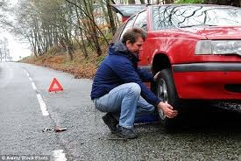
Hardware vs. Software Reliability
Hardware failures:
  Inherently different from software failures.
Most hardware failures are due to component wear and tear:
  some component no longer functions as specified.

Slide 20
Hardware vs. Software Reliability
A logic gate can be stuck at 1 or 0,
  or a resistor might short circuit.
To fix hardware faults:
  Replace or repair the failed part.

Slide 21
Hardware vs. Software Reliability
Software failures are never due to wear and tear!
  ➔ system will continue to fail:
    Unless changes are made to the software design and code.

Slide 22
Hardware vs. Software Reliability
  Many metrics exist for satisfactory measurements hardware reliability.
    These however are not suitable for software reliability measurements:
    Because of the fundamental differences between their characteristics.

Slide 23
Hardware vs. Software Reliability
When a hardware is repaired:
  its reliability is maintained
When software is repaired:
  its reliability may increase or decrease.

Slide 24
Hardware vs. Software Reliability
Goal of hardware reliability study:
  stability (i.e. interfailure times remains constant)
Goal of software reliability study
  reliability growth (i.e. interfailure times increases)

Slide 25

Hardware Failure Curve
Failure
Rate
Burn
in
Useful life
Burn out
Time

Slide 26
Software Failure Curve
Failure
Rate
Increased Failure Rate
Change
Actual Curve
Idealized Curve
Time

Slide 27
Reliability Metrics
A good reliability measure should be observer-independent,
  so that different people can agree on the reliability.

Slide 28
Rate of occurrence of failure (ROCOF)
ROCOF measures:
  frequency of occurrence failures.
  observe the behavior of a software product in operation:
    over a specified time interval
    calculate the total number of failures during the interval.

Slide 29
Mean Time To Failure (MTTF)
Average time between two successive failures:
  observed over a large number of failures.
Failure
Correct operation

Slide 30
Mean Time To Failure (MTTF)
MTTF is not as appropriate for software as for hardware:
  A Hardware system fails due to a component’s wear and tear.
    MTTF indicates how frequently the system fails
  When a software error is detected and repaired:
    the same error never appears.

Slide 31
Mean Time To Failure (MTTF)
We can record failure data for n failures:
  let these be t1, t2, …, tn
  calculate (t_{i+1}-t_{i})
  the average value is MTTF
  Σ (t_{i+1}-t_{i})/(n-1)
Failure
Correct operation

Slide 32
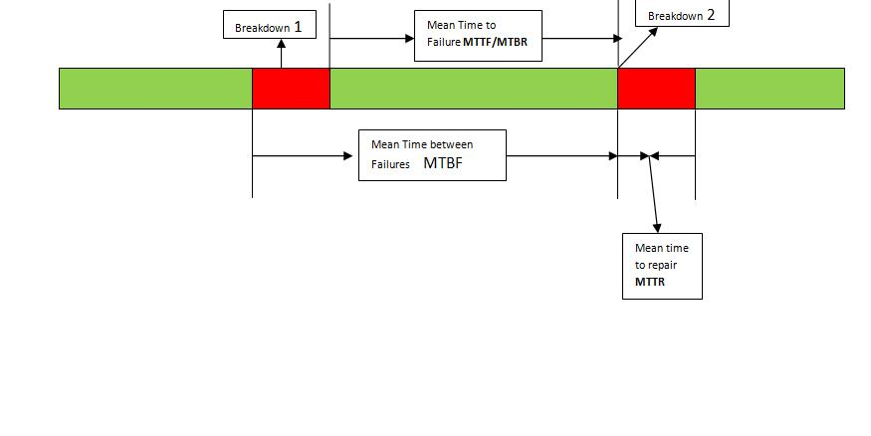
Mean Time to Repair (MTTR)
Once failure occurs:
  Some time taken to fix faults
MTTR:
  measures average time it takes to fix faults.

Slide 33
Mean Time Between Failures (MTBF)
We can combine MTTF and MTTR:
  to get an availability metric:
  MTBF=MTTF+MTTR
MTBF of 100 hours would indicate:
  Once a failure occurs, the next failure is expected after 100 hours of clock time (not running time).

Slide 34
Probability of Failure on Demand (POFOD)
Unlike other metrics
  This metric does not explicitly involve time.
Measures the likelihood of the system failing:
  when a service request is made.
  POFOD of 0.001 means:
    1 out of 1000 service requests may result in a failure.

Slide 35
Availability
Measures how likely the system shall be available for use over a period of time:
  considers the number of failures occurring during a time interval,
  also takes into account the repair time (down time) of a system.

Slide 36
Availability
This metric is important for systems like:
  telecommunication systems,
  operating systems, etc. which are supposed to be never down
  where repair and restart time are significant and loss of service during that time is important.

Slide 37
Reliability metrics
All reliability metrics we discussed:
  centered around the probability of system failures:
  take no account of the consequences of failures.
    severity of failures may be very different.

Slide 38
Failure Classes
Transient:
  Transient failures occur only for certain inputs.
Permanent:
  Permanent failures occur for all input values.
Recoverable:
  When recoverable failures occur:
    the system recovers with or without operator intervention.

Slide 39
Failure Classes
Unrecoverable:
  the system may have to be restarted.
Cosmetic:
  These failures just cause minor irritations,
    do not lead to incorrect results.
  An example of a cosmetic failure:
    mouse button has to be clicked twice instead of once to invoke a GUI function.

Slide 40
Reliability Growth Modelling
A reliability growth model:
  a model of how software reliability grows
    as errors are detected and repaired.
A reliability growth model can be used to predict:
  when (or if at all) a particular level of reliability is likely to be attained.
  i.e. how long to test the system?

Slide 41
Step Function Model
The simplest reliability growth model:
  a step function model
The basic assumption:
  reliability increases by a constant amount each time an error is detected and repaired.

Slide 42
Step Function Model
ROCOF
Time

Slide 43
Step Function Model
Assumes:
  all errors contribute equally to reliability growth
  highly unrealistic:
    we already know that different errors contribute differently to reliability growth.

Slide 44
Jelinski and Moranda Model
Realizes each time an error is repaired:
  reliability does not increase by a constant amount.
Reliability improvement due to fixing of an error:
  assumed to be proportional to the number of errors present in the system at that time.

Slide 45
Jelinski and Moranda Model
Realistic for many applications,
  still suffers from several shortcomings.
  Most probable failures (failure types which occur frequently):
    discovered early during the testing process.

Slide 46
Jelinski and Moranda Model
Repairing faults discovered early:
  contribute maximum to the reliability growth.
Rate of reliability growth should be large initially:
  slow down later on,
  contrary to assumption of the model

Slide 47
Littlewood and Verall’s Model
Allows for negative reliability growth:
  when software repair introduces further errors.
  Models the fact that as errors are repaired:
    average improvement in reliability per repair decreases.

Slide 48
Littlewood and Verall’s Model
Treats a corrected bug’s contribution to reliability improvement:
  an independent random variable having Gamma distribution.
Removes bugs with large contributions to reliability:
  earlier than bugs with smaller contribution
  represents diminishing return as test continues.

Slide 49
Reliability growth models
There are more complex reliability growth models,
  more accurate approximations to the reliability growth.
  these models are out of scope of our discussion.

Slide 50
Applicability of Reliability Growth Models
There is no universally applicable reliability growth model.
Reliability growth is not independent of application.

Slide 51
Applicability of Reliability Growth Models
Fit observed data to several growth models.
  Take the one that best fits the data.

Slide 52
Statistical Testing
A testing process:
  the objective is to determine reliability rather than discover errors.
  uses data different from defect testing.

Slide 53
Statistical Testing
Different users have different operational profile:
  i.e. they use the system in different ways
  formally, operational profile:
    probability distribution of input

Slide 54
Operational profile: Example
An expert user might give advanced commands:
  use command language interface, compose commands
A novice user might issue simple commands:
  using iconic or menu-based interface.

Slide 55
Statistical Testing
Relies on using large test data set.
Assumes that only a small percentage of test inputs:
  likely to cause system failure.

Slide 56
Statistical Testing
It is straight forward to generate tests corresponding to the most common inputs:
  but a statistically significant percentage of unlikely inputs should also be included.
Creating these may be difficult:
  especially if test generators are used.

Slide 57
Advantages of Statistical Testing
Concentrate on testing parts of the system most likely to be used:
  results in a system that the users find more reliable (than actually it is!).

Slide 58
Advantages of Statistical Testing
Reliability predictions based on test results:
  gives an accurate estimation of reliability (as perceived by the average user) compared to other types of measurements.

Slide 59
Disadvantages of Statistical Testing
It is not easy to do statistical testing properly:
  there is no simple or repeatable way to accurately define operational profiles.
Statistical uncertainty.

